Slide 1
iNeuron Internship Project
Adult Census Income Prediction
(With complete CI/CD Pipeline)
Rajendra K Jadhav
Rushikesh B Chalake

Slide 2
Introduction
The Adult Census Income Prediction project involves building a machine learning model to predict an individual's income level based on their demographic and socioeconomic characteristics. The project also involves creating an end-to-end solution, including data preprocessing, feature engineering, model selection, and model training. The performance of the model will be evaluated on a test set, and the best model will be deployed in a production environment. The project will also incorporate continuous integration and continuous delivery (CI/CD) pipelines to automate the building, testing, and deployment of the machine learning model. The end result is a comprehensive solution that can accurately predict an individual's income level and can be quickly and reliably deployed in a production environment.

Slide 3
Problem Statement
The problem we are trying to solve is to classify individuals based on their income level, which can be used for a variety of purposes such as targeted marketing, policy-making, and social research. Therefore, the objective of this project is to develop a machine learning model that can accurately predict an individual's income level based on their demographic and socioeconomic characteristics. The Goal is to predict whether a person has an income of more than 50K a year or not. This is basically a binary classification problem where a person is classified into the >50K group or <=50K group.

Slide 4
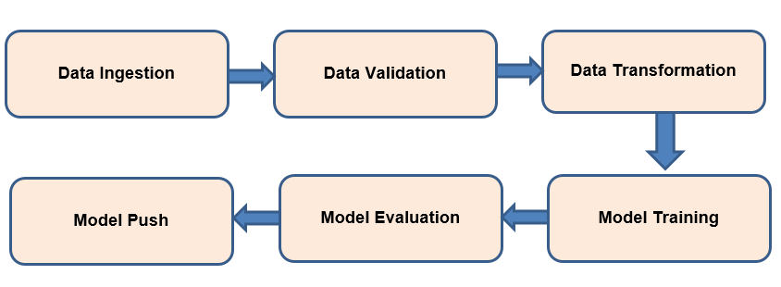
Components of Machine Learning Pipeline

Slide 5
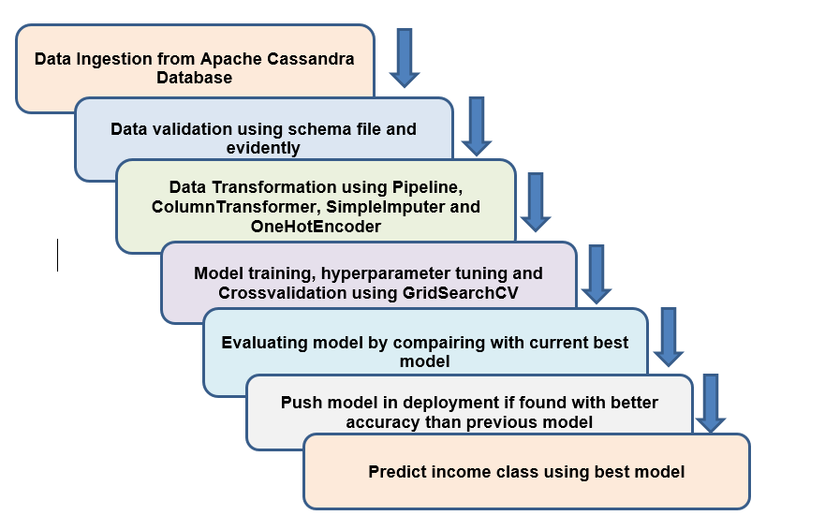
Complete Pipeline Flow

Slide 6
Architecture Description
Data Description:
The dataset named Adult Census Income is available in kaggle and UCI repository. This data was extracted from the 1994 census bureau dataset by Ronny Kohavi and Barry Becker (Data Mining and Visualization, Silicon Graphics). The prediction task is to determine whether a person makes over $50K a year or not.
Data Ingestion:
Loading data form the apache Cassandra database by establishing connection with database cluster. Ingested data will be in the form of csv file. Splitting file into train and test file using stratified split.

Slide 7
Architecture Description
Data Validation:
Validating data using schema.yaml file and generating report using evidently package. Checking for data drift.
Data transformation:
Removing unnecessary columns from dataframe. Transforming data using various Pipeline, ColumnTransformer, SimpleImputer and OneHotEncoder. Saving preprocessing object in pickle file.
Model Training:
Training different model using transformed with crossvalidation and gridsearchCV.

Slide 8
Architecture Description
Model Evaluation:
Evaluating model performance using various performance metrics. Finding the best model by compairing different models.
Model Push:
Deploying the model in production only if better model found. Prediction will be done using this model.
Deployment on railway:
Deployment using github repository on railway cloud. Automating deployment using github actions. Then, app will automatically get updated when we commit any changes to main branch of github repository.

Slide 9








Tools
Visual Studio Code is used as IDE.
For visualization of the plots, Matplotlib, Seaborn are used.
Railway is used for deployment of the model.
Apache Cassandra is used to retrieve, insert, delete, and update the database.
Front end development is done using HTML/CSS
Python Flask is used for backend development.
GitHub is used as version control system.
Scikit-learn was used to cross validate and compare different models.
GradientBoostingClassifier is used to build the final model.

Slide 10
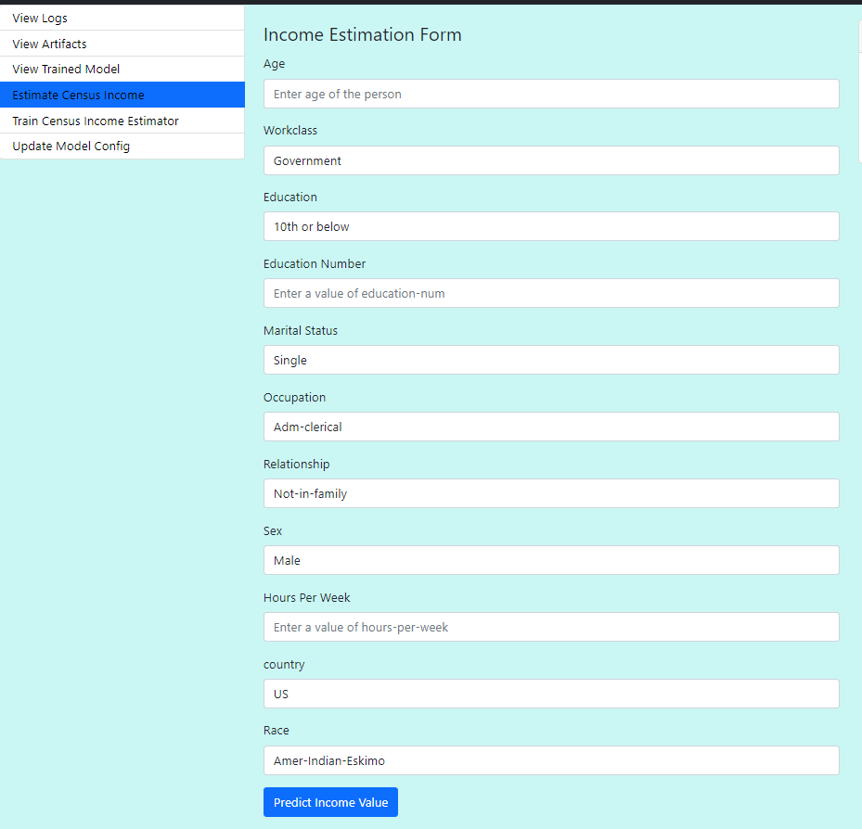
Application Interface

Slide 11
Conclusions
Best model found after evaluation - GradientBoostClassifier with 84% accuracy.
The Income Prediction will give the income predictions of a person instantly and has the potential to help various organisations, agecies, companies, etc around the world in various tasks.

Slide 12
THANK YOU….!
jadhavrajendra9923@gmail.com

